Slide 1
Unit 2. Non-LOS Propagation and Link Budget Analysis
EL-GY 6023: Wireless Communications
Prof. Sundeep rangan

Slide 2
Learning Objectives
Perform simple noise and interference calculations
Define key communication requirements
BER, BLER, information rate, spectral efficiency, bandwidth
SNR: Energy per bit and energy per symbol
Estimate rate based on simple models or from link curves
Perform simple link budget calculations
Qualitatively describe various propagation mechanisms in real world settings
Compute reflected power from the radar equation
Generate samples from a statistical path loss model
Compute rate and SNR distributions using a statistical path loss model

Slide 3
Outline
Noise, Interference and SNR
Communication Requirements and Link Budget Analysis
Non-LOS Propagation
Statistical Models for Path Loss
Demo: Estimating Rates with a 3GPP model

Slide 4
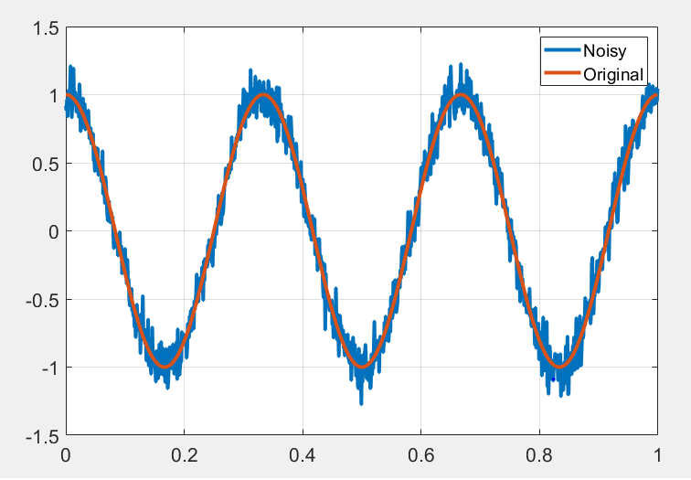
What is Noise?
Noise: Any unwanted component of the signal
Key challenge in communication:
Estimate the transmitted signal in the presence of noise

Slide 5
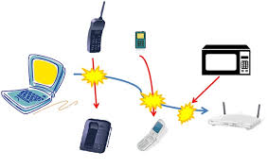
Types of “Noise”
Internal / thermal noise:
From imperfections in the receiver
Thermal noise: From random fluctuations of electrons
Distortions:
Phase noise, quantization, channel estimation errors
Not really noise, but sometimes modeled as noise
External Interference
Signals from other sources
In-band: Transmitters in the same frequency Ex: Multiple devices in a cellular band
Out-of-band: From leakage out of carrier
Some texts do not consider “interference” as noise

Slide 6
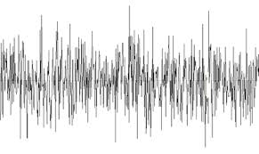
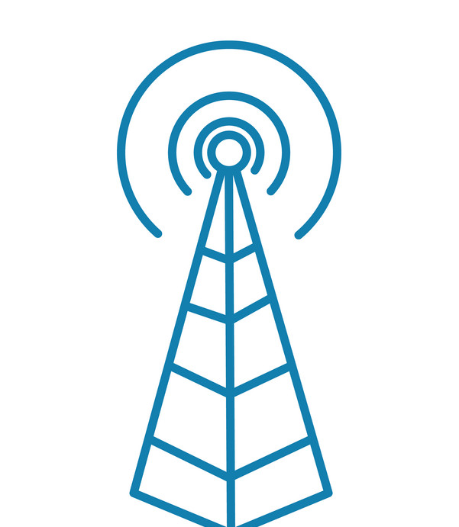

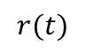
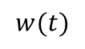
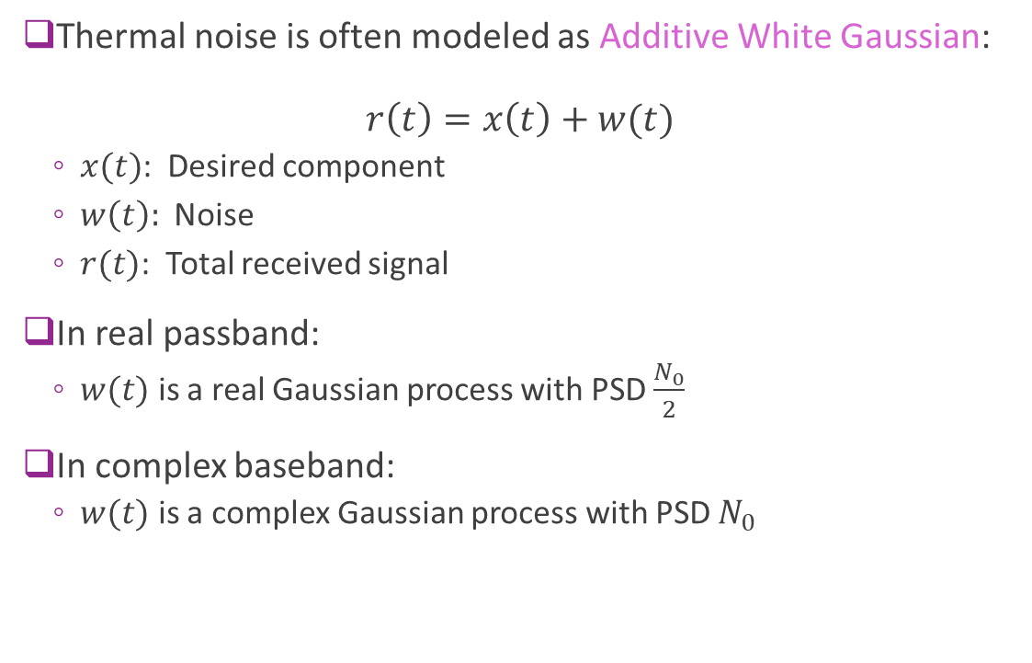
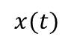
AWGN Noise Model
Thermal noise is often modeled as Additive White Gaussian: $r\left(t\right)=x\left(t\right)+w(t)$
$x(t)$: Desired component
$w\left(t\right):$ Noise
$r(t)$: Total received signal
In real passband:
$w(t)$ is a real Gaussian process with PSD $\frac{N_{0}}{2}$
In complex baseband:
$w(t)$ is a complex Gaussian process with PSD $N_{0}$
$$w(t)$$
$$x(t)$$
$$r(t)$$

Slide 7
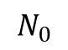
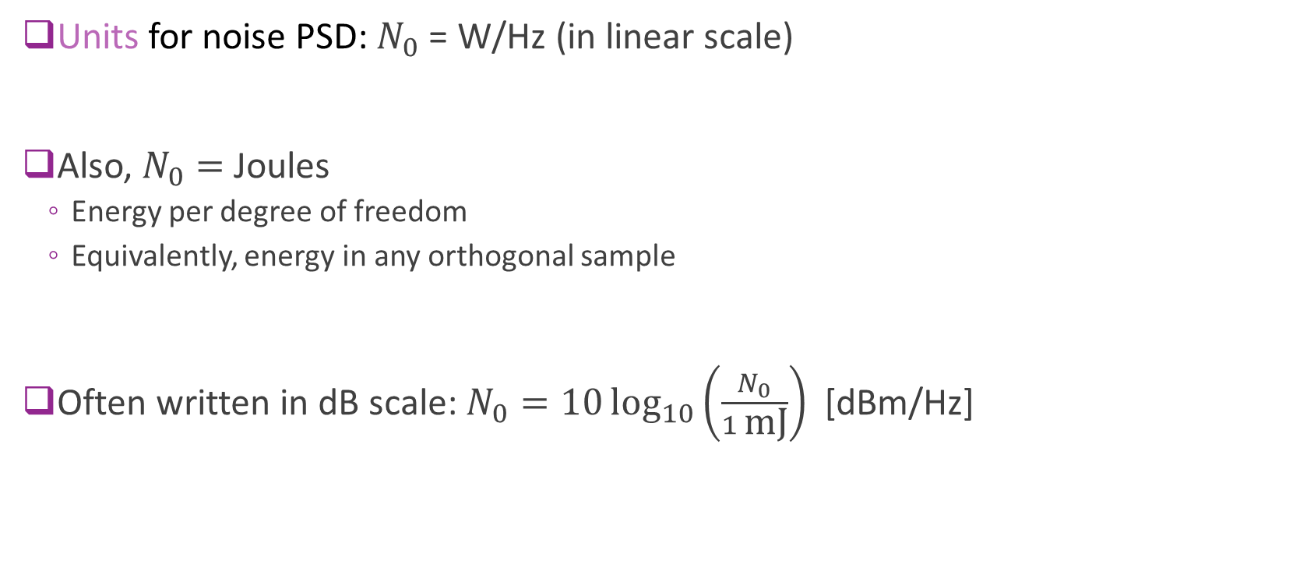
Thermal Noise Units
Units for noise PSD: $N_{0}$ = W/Hz (in linear scale)
Also, $N_{0}=$ Joules
Energy per degree of freedom
Equivalently, energy in any orthogonal sample
Often written in dB scale: $N_{0}=10\log_{10}\left(\frac{N_{0}}{1 \text{mJ}}\right)$ [dBm/Hz]
PSD [dBm/Hz]
$$N_{0}$$
Freq [Hz]

Slide 8
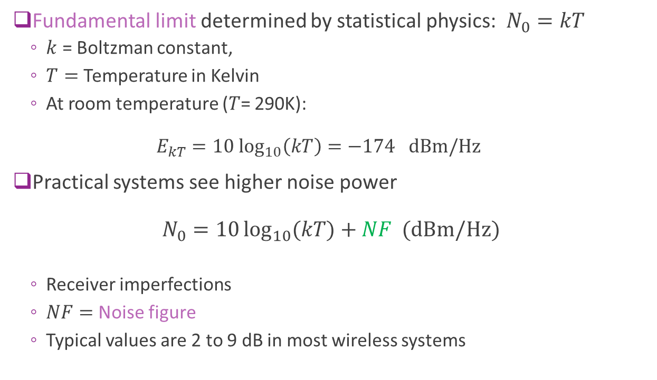
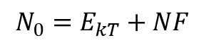

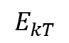
Limits and Noise Figure
Fundamental limit determined by statistical physics: $N_{0}=kT$
$k$ = Boltzman constant,
$T=$ Temperature in Kelvin
At room temperature ($T$= 290K): $E_{kT}=10 \log_{10}\left(kT\right)=−174 dBm/Hz$
Practical systems see higher noise power $N_{0}=10\log_{10}{(kT)}+NF \text{(}\text{dBm}\text{/}\text{Hz}\text{)}$
Receiver imperfections
$NF=$Noise figure
Typical values are 2 to 9 dB in most wireless systems
PSD [dBm/Hz]
$$N_{0}=E_{kT}+NF$$
$$NF$$
$$E_{kT}$$
Freq [Hz]

Slide 9
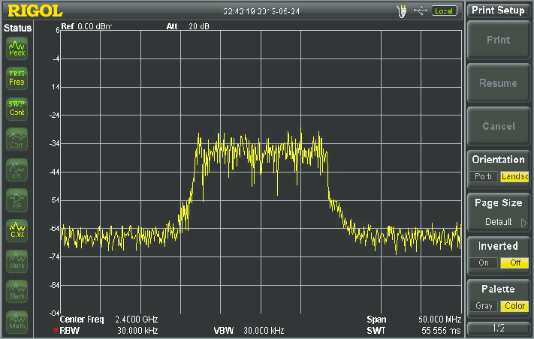

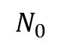
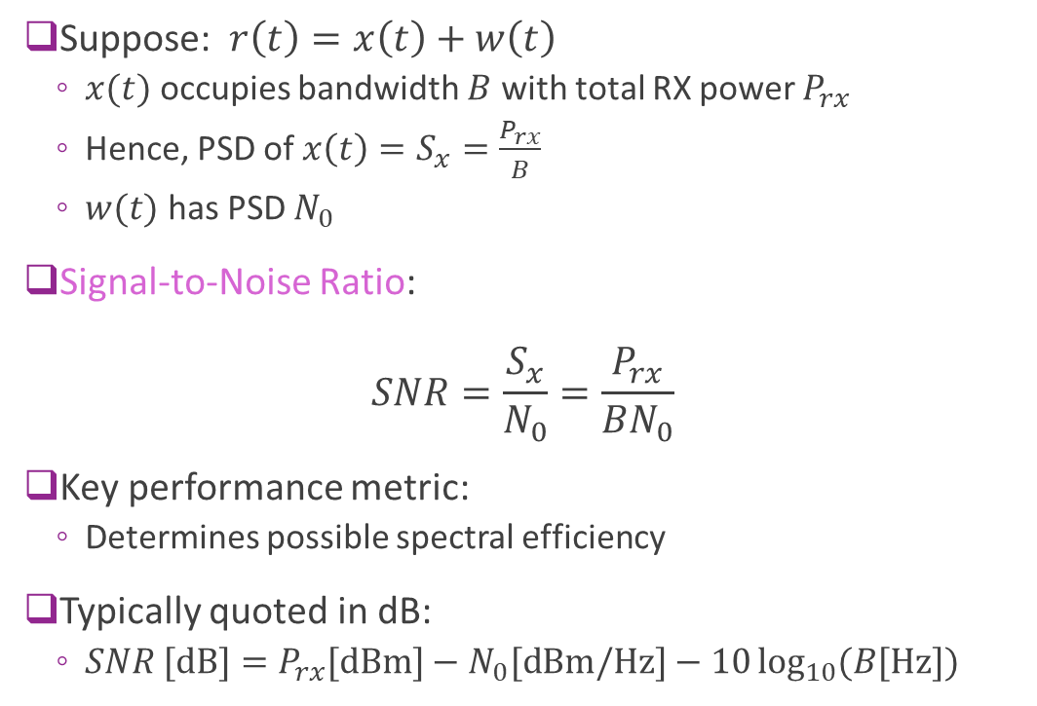
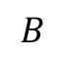
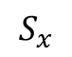

Signal To Noise Ratio
Suppose: $r\left(t\right)=x\left(t\right)+w\left(t\right)$
$x(t)$ occupies bandwidth $B$ with total RX power $P_{rx}$
Hence, PSD of $x\left(t\right)=S_{x}=\frac{P_{rx}}{B}$
$w(t)$ has PSD $N_{0}$
Signal-to-Noise Ratio: $SNR=\frac{S_{x}}{N_{0}}=\frac{P_{rx}}{BN_{0}}$
Key performance metric:
Determines possible spectral efficiency
Typically quoted in dB:
$SNR \text{[}\text{dB}\text{]}=P_{rx}\text{[}\text{dBm}\text{]}−N_{0}\text{[}\text{dBm}\text{/}\text{Hz}\text{]}−10\log_{10}{(B\text{[}\text{Hz}\text{]})}$
PSD [dBm/Hz]
$$S_{x}$$
$$SNR$$
$$N_{0}$$
Freq [Hz]
$$B$$
$$SNR$$

Slide 10
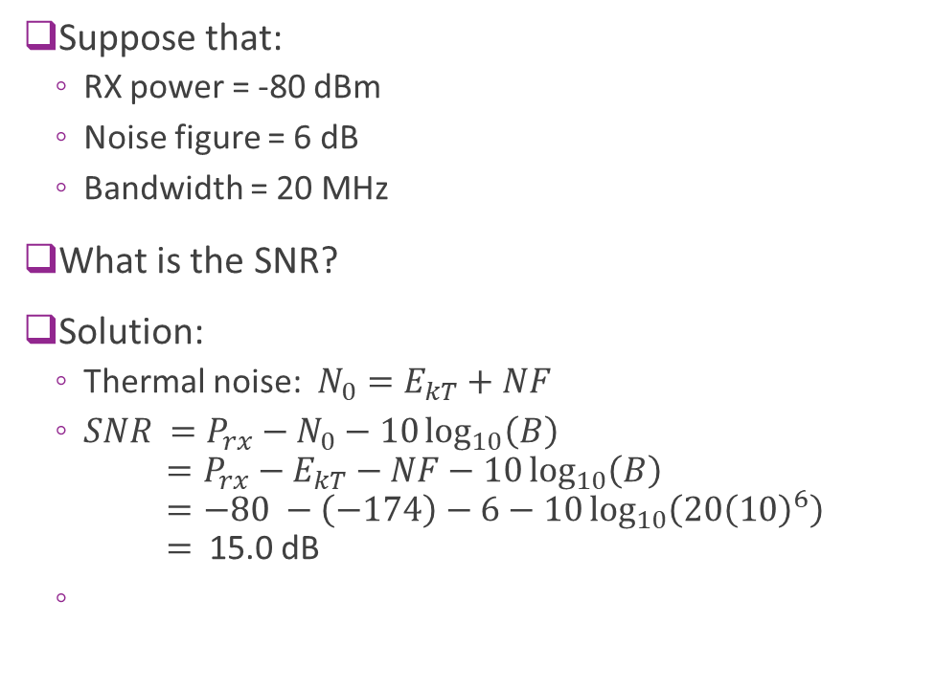
Example: SNR Calculation
Suppose that:
RX power = -80 dBm
Noise figure = 6 dB
Bandwidth = 20 MHz
What is the SNR?
Solution:
Thermal noise: $N_{0}=E_{kT}+NF$
$SNR =P_{rx}−N_{0}−10\log_{10}\left(B\right)$ $=P_{rx}−E_{kT}−NF−10\log_{10}\left(B\right)$ $=−80 −\left(−174\right)−6−10\log_{10}\left(20{\left(10\right)}^{6}\right)$ $=$ 15.0 dB
PSD [dBm/Hz]
$$S_{x}$$
$$SNR$$
$$N_{0}$$
Freq [Hz]
$$B$$

Slide 11
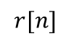
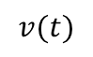
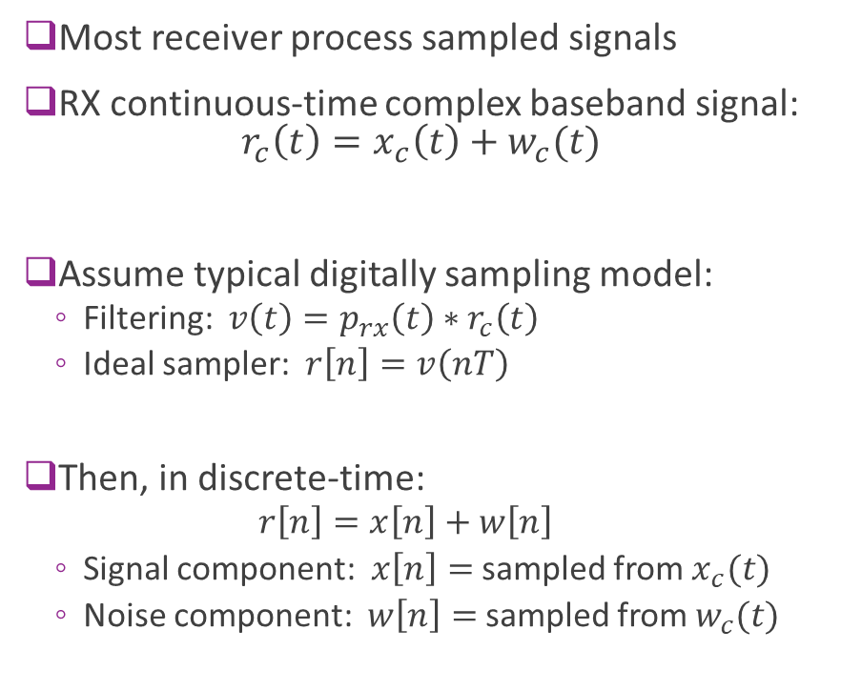
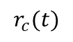
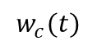
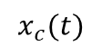
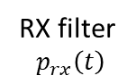
Sampled Data Systems
Most receiver process sampled signals
RX continuous-time complex baseband signal: $r_{c}\left(t\right)=x_{c}\left(t\right)+w_{c}(t)$
Assume typical digitally sampling model:
Filtering: $v\left(t\right)=p_{rx}\left(t\right)∗r_{c}\left(t\right)$
Ideal sampler: $r\left[n\right]=v\left(nT\right)$
Then, in discrete-time:
$$r\left[n\right]=x\left[n\right]+w\left[n\right]$$
Signal component: $x\left[n\right]=$ sampled from $x_{c}(t)$
Noise component: $w\left[n\right]=$ sampled from $w_{c}(t)$
$$w_{c}(t)$$
$$x_{c}(t)$$
$$r_{c}(t)$$
$$v(t)$$
$$r[n]$$
RX filter $$p_{rx}\left(t\right)$$
Ideal sampler

Slide 12
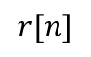
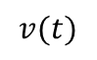
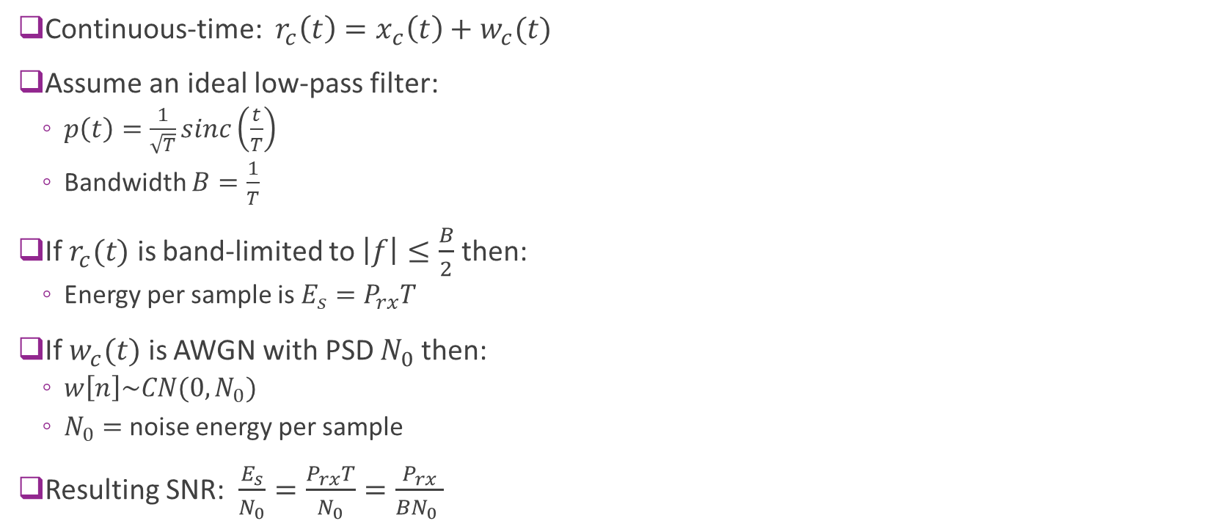
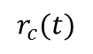
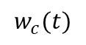
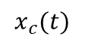
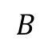
SNR in Sampled Data Systems
Continuous-time: $r_{c}\left(t\right)=x_{c}\left(t\right)+w_{c}(t)$
Assume an ideal low-pass filter:
$p\left(t\right)=\frac{1}{\sqrt{T}}sinc\left(\frac{t}{T}\right)$
Bandwidth $B=\frac{1}{T}$
If $r_{c}(t)$ is band-limited to $\left|f\right|≤\frac{B}{2}$ then:
Energy per sample is $E_{s}=P_{rx}T$
If $w_{c}(t)$ is AWGN with PSD $N_{0}$then:
$w\left[n\right]\sim CN(0,N_{0})$
$N_{0}=$ noise energy per sample
Resulting SNR: $\frac{E_{s}}{N_{0}}=\frac{P_{rx}T}{N_{0}}=\frac{P_{rx}}{BN_{0} }$
$$w_{c}(t)$$
$$x_{c}(t)$$
$$r_{c}(t)$$
$$v(t)$$
$$r[n]$$
RX filter
Ideal sampler
Freq [Hz]
$$B$$

Slide 13
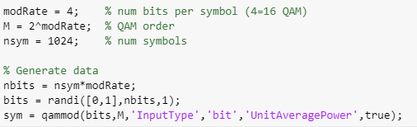
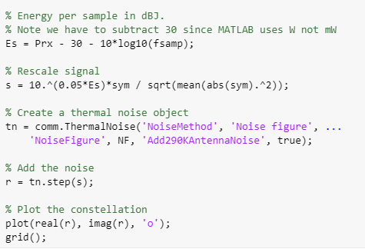
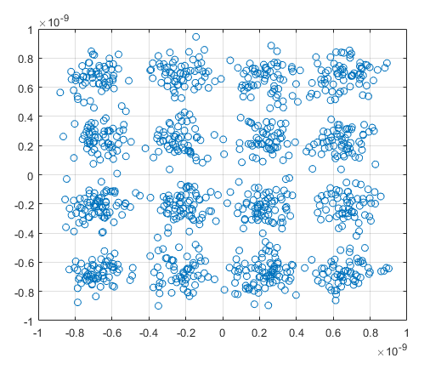
Simulating Noise in MATLAB
Simulating noise is easy in MATLAB
Example in demo:
Generate 16-QAM symbols
Scale for the RX power
Add thermal noise

Slide 14
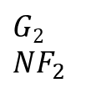
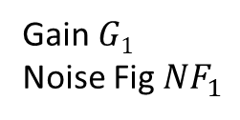
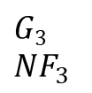
Cascade of Elements
Gain stage 1
Stage 2
Stage 3
Output power
P_{out}
Input power
P_{in}
Gain $G1$
Noise Fig $NF_{1}$
$G2$
$NF_{2}$
$G3$
$NF_{3}$
Most receivers are built with multiple stages
Ex: LNA, Mixer, …
Each stage has a gain and noise figure
Some stages (typically amplifiers) add noise with a noise figure

Slide 15
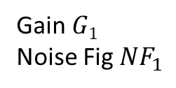
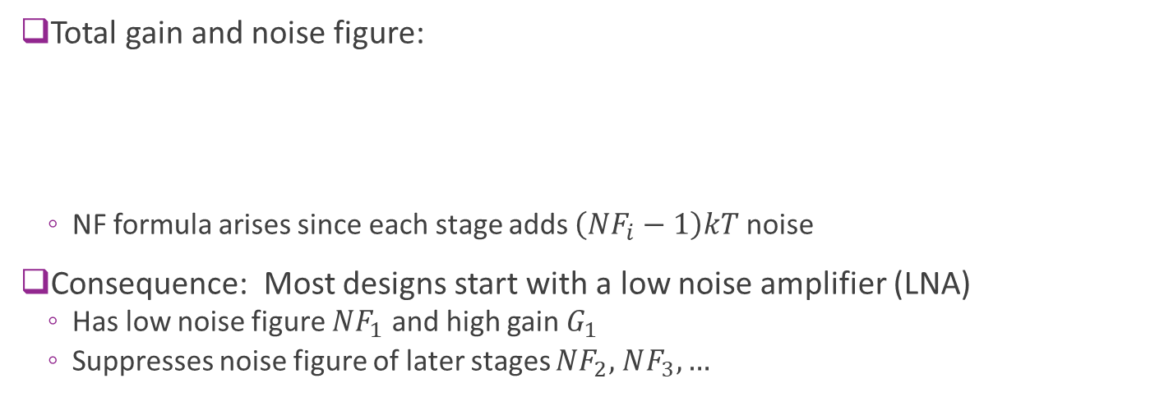
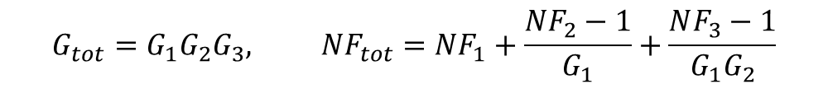
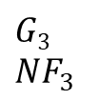
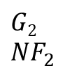
NF for Cascade of Elements
Output power
P_{out}
Input power
P_{in}
Gain $G1$
Noise Fig $NF_{1}$
$G2$
$NF_{2}$
$G3$
$NF_{3}$
Total gain and noise figure:
NF formula arises since each stage adds $\left(NF_{i}−1\right)kT$ noise
Consequence: Most designs start with a low noise amplifier (LNA)
Has low noise figure $NF_{1}$ and high gain $G_{1}$
Suppresses noise figure of later stages $NF_{2},$ $NF_{3}, …$
$$G_{tot}=G_{1}G_{2}G_{3}, {NF}_{tot}=NF_{1}+\frac{NF_{2}−1}{G_{1}}+\frac{NF_{3}−1}{G_{1}G_{2}}$$

Slide 16
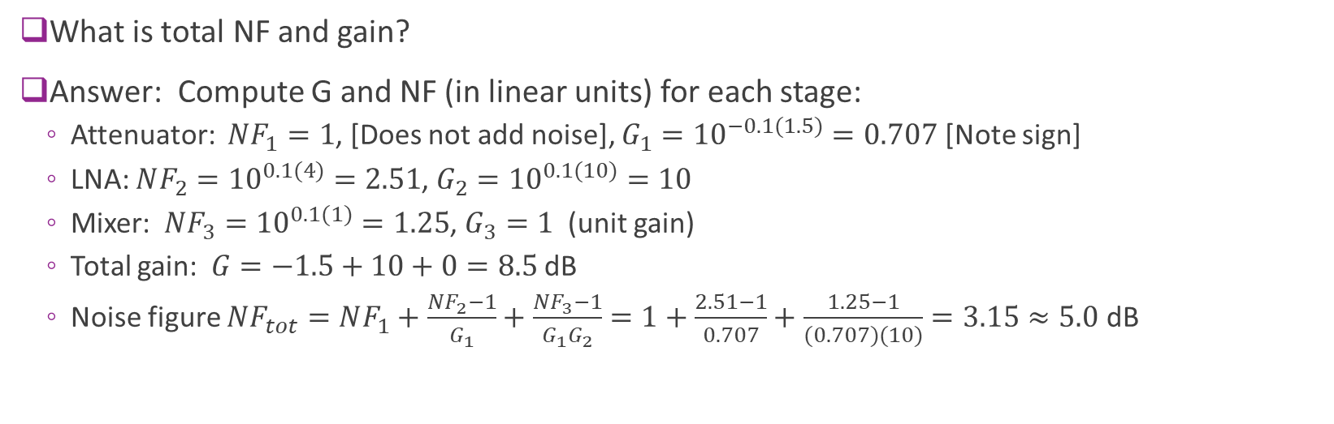
Example Problem Molisch 3.1
Attn connector
Loss = 1.5 dB
Low noise amp
Gain = 10 dB, NF = 4 dB
Mixer
Unit gain, NF = 1 dB
Gain G₁
Gain G₂
Gain G₃
NF₁
NF₂
NF₃
What is total NF and gain?
Answer: Compute G and NF (in linear units) for each stage:
Attenuator: $NF_{1}=1$, [Does not add noise], $G_{1}={10}^{−0.1(1.5)}=0.707$[Note sign]
LNA: $NF_{2}={10}^{0.1(4)}=2.51$, $G_{2}={10}^{0.1(10)}=10$
Mixer: $NF_{3}={10}^{0.1(1)}=1.25$, $G_{3}=1$ (unit gain)
Total gain: $G=−1.5+10+0=8.5$ dB
Noise figure $NF_{tot}=NF_{1}+\frac{NF_{2}−1}{G_{1}}+$ $\frac{NF_{3}−1}{G_{1}G_{2}}=1+\frac{2.51−1}{0.707}+\frac{1.25−1}{(0.707)(10)}=3.15≈5.0$dB

Slide 17
Interference
Signals from other transmitters using same band and same time.
Fundamental to the broadcast nature of the wireless medium.
Adds to total noise seen at receiver
Example:
A transmits to B (desired signal)
C transmits to D (desired signal)
But B gets interference from A
C
Desired
D
A
B
Interference
Desired signal

Slide 18
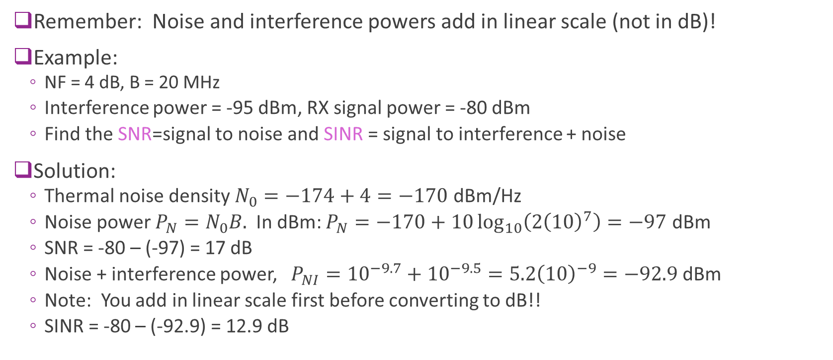
Interference Calculations
Remember: Noise and interference powers add in linear scale (not in dB)!
Example:
NF = 4 dB, B = 20 MHz
Interference power = -95 dBm, RX signal power = -80 dBm
Find the SNR=signal to noise and SINR = signal to interference + noise
Solution:
Thermal noise density $N_{0}=−174+4=−170$ dBm/Hz
Noise power $P_{N}=N_{0}B.$ In dBm: $P_{N}=−170+10\log_{10}\left(2{\left(10\right)}^{7}\right)=−97$ dBm
SNR = -80 – (-97) = 17 dB
Noise + interference power, $P_{NI}={10}^{−9.7}+{10}^{−9.5}=5.2{\left(10\right)}^{−9}=−92.9$dBm
Note: You add in linear scale first before converting to dB!!
SINR = -80 – (-92.9) = 12.9 dB

Slide 19
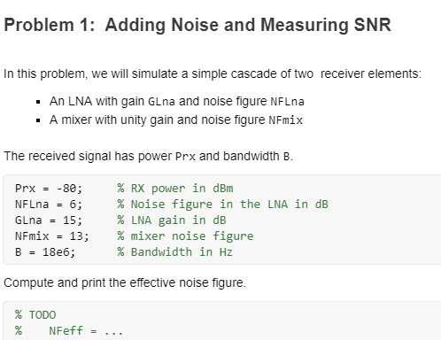
In-Class Problem
Cascade of two elements
LNA
Mixer
Simulation:
Transmit symbols
Add noise in each stage
Measure resulting SNR

Slide 20
Outline
Noise and Interference
Communication Requirements and Link Budget Analysis
Non-LOS Propagation
Statistical Models for Path Loss
Demo: Estimating Rates with a 3GPP model

Slide 21
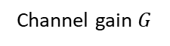
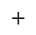
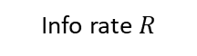



Communication Requirements
TX power $P_{tx}$, BW $B$
Noise PSD $N_{0}$
RX power $P_{rx}$
Info rate $R$
TX
$+$
RX
Channel gain $G$
Basic tradeoff in all communication systems:
Information rate: Amount of information we try to send
Bandwidth: Spectrum the signal occupies
Reliability: The probability it is received correctly
Channel quality: Typically measured by the signal to noise ratio

Slide 22





Review: Typical Transmitter Steps
Coded bits
Complex symbols
Baseband
analog
Power $P_{tx}$
Info bits Rate = $R$
Channel coding rate $R_{cod}$
Modulation $f_{s}=\frac{1}{T_{s}}$ sym/sec
DAC + filtering $α$ excess BW frac
Upconversion
+ Power amp
Communication systems typically use four stages
Channel coding: ex. Convolutional, turbo, LDPC
Modulation: QPSK, 16-QAM, 64-QAM, …
Pulse shaping or transmit filtering
Upconversion
Determines modulation + coding scheme (MCS)

Slide 23


Information Rate and Bandwidth
Coded bits
Complex symbols
Baseband
analog
Power $P_{tx}$
Info bits Rate = $R$
Channel coding rate $R_{cod}$
$f_{s}=\frac{1}{T_{s}}$ sym/sec $R_{mod}$ bits/sym
DAC + filtering $α$ excess BW frac
Upconversion
+ Power amp
Information rate: $R=R_{cod}R_{mod}f_{s}$ [bits/sec]
Signal bandwidth: $f_{s}$ [Hz]
Occupied bandwidth: $B=\left(1+α\right)f_{s}$ [Hz]
Spectral efficiency $\frac{R}{B}$ (Units are bps/Hz or bits/DOF)

Slide 24

Example Calculation
Coded bits
Complex symbols
Baseband
analog
Power $P_{tx}$
Info bits Rate = $R$
Channel coding rate $R_{cod}$
$f_{s}=\frac{1}{T_{s}}$ sym/sec $R_{mod}$ bits/sym
DAC + filtering $α$ excess BW frac
Upconversion
+ Power amp
Ex: A system transmits with rate ½ coding, 16-QAM, 10 Msym/s and excess BW 10%
The modulation and code rate are $R_{cod}=\frac{1}{2}$ ; $R_{mod}=4$ (16-QAM)
Sample rate $f_{s}=10$ Msym/s
Excess bandwidth $α=0.1$
Hence information rate is $R=R_{cod}R_{mod}f_{s}=\left(0.5\right)\left(4\right)\left(10\right)=20$ Mbps
Occupied bandwidth = $B=\left(1+α\right)f_{s}=\left(1.1\right)\left(10\right)=11$MHz

Slide 25
Reliability: BER and BLER
TX bits in coding blocks
RX bits in coding blocks
TX
RX
Error
Most communication system TX data into blocks
Framing may be used for coding, MAC layer transport blocks or IP layer
Range in size from 100s to > 10000 bits per blocks
Measure reliability by either:
BER: Bit error rate = fraction of bits in error (useful when there is no blocks)
BLER: Block error rate = fraction of blocks that have at least one error
Errors typically need to be corrected at some higher layer
Retransmissions / ARQ at MAC or transport layer (A lot more on this later!)
Corrected by application (e.g. voice masking in audio)
Acceptable level for BER and BLER depend on many MAC and application layer factors

Slide 26






SNR and Power Relations
$$P_{tx}$$
Noise PSD $N_{0}$
$$P_{rx}={GP}_{tx}$$
Symbol rate=$f_{s}$
Estimated bits
Rate $R$
TX symbols
+
RX symbols
Info bits
Pathloss
Equalization, demod,
decoding
Coding + modulation
DAC+ TX filter
Upconversion
Down-conversion
ADC +
RX filter
Channel quality is measured by SNR = signal to noise ratio
SNR per symbol: $\frac{E_{s}}{N_{0}}=\frac{P_{rx}T_{s}}{N_{0}}$
SNR per bit $\frac{E_{b}}{N_{0}}=\frac{P_{rx}}{N_{0}R}$ (pronounced “ebb-no”)
Requirement will depend on the MCS used and the quality of the receiver

Slide 27


Example Problem
A system uses:
Convolutional code shown ($K=5$) and $R_{cod}=\frac{1}{2}$, 16-QAM
Symbol rate $f_{s}=100$ Msym/s. No excess bandwidth
Transmit power: 23 dBm
RX noise PSD: -170 dBm/Hz (including NF)
For a BER of ${10}^{−4}$ find the maximum path loss
Solution:
From graph we need $γ_{b}=\frac{E_{b}}{N_{0}}≈4.5$dB
Information rate is $R=R_{cod}R_{mod}f_{s}=\left(0.5\right)\left(4\right)\left(100\right)=200$Mbps
$γ_{b}=\frac{E_{b}}{N_{0}}=\frac{P_{rx}}{N_{0}f_{s}}$.
In dB scale: $P_{rx}=γ_{b}+10\log_{10}\left(R\right)+N_{0}=4.5+3+80−170=−82.5$dBm
Hence, max path loss is $L=P_{tx}−P_{rx}=23−\left(−82.5\right)=105.5$ dB
From Proakis

Slide 28

Shannon Capacity
Capacity = max rate achievable given bandwidth and SNR
Rate optimized over all possible MCSs and communication schemes.
Given by classic Shannon formula $C=B\log_{2}\left(1+γ\right), γ=SNR=\frac{P_{rx}}{N_{0}B}$
Capacity relates theoretical rate to two key parameters:
B = bandwidth in Hz
SNR in linear scale (not dB!!!)
Max spectral efficiency $\frac{C}{B}=$ max bps/Hz
Mathematical result from classic paper in 1948.

Slide 29


Bandwidth and Power-Limited Regions
Shannon formula: $C=B\log_{2}\left(1+γ\right)=B\log_{2}\left(1+\frac{P_{rx}}{N_{0}B}\right)$
Power-Limited region:
As $B→∞, C→\log_{2}{(e)}\frac{P_{rx}}{N_{0}}$
Rate linearly increases with power / SNR $\frac{P_{rx}}{N_{0}}$
Bandwidth-limited region:
For large SNR, $C≈B\log_{2}\left(γ\right)$
Linearly increases in bandwidth,
Logarithmically increase in SNR.
Increasing SNR has little practical value

Slide 30

Actual Rate vs. Shannon Capacity
Theoretical Shannon capacity cannot be achieved
Needs infinite computation and delay.
Practical modems achieve a rate below Shannon limit.
Useful model: $R=\left(1−Δ\right)B\min{\{\log_{2}\left(1+βγ\right)\text{, }ρ_{max}\} }$
Δ=fraction overhead
β=loss factor, usually quoted in dB
Often say “system is β dB below capacity”
$γ_{\text{eff}}=βγ$ can be thought of as an “effective” SNR
Usually loss from capacity is at least 3dB
Often higher depending on receiver complexity and other factors

Slide 31

Rate vs. Capacity Example
What is the maximum rate for a system:
20% overhead, 10 MHz bandwidth, SNR=12 dB
Operates at 3dB below Shannon capacity
Answer:
Effective SNR: $γ_{\text{eff}}=12−3=9$dB. In linear scale $γ_{\text{eff}}=8$(since 9=3(3))
Therefore, $R=\left(1−Δ\right)B\log_{2}\left(1+βγ\right)=\left(0.8\right)\left(10\right)\log_{2}{(1+8)}=25.3$ Mbps
Note the final units are in Mbps

Slide 32
Example Link Budget
Item | Value | Remarks
Transmit power (dBm) | 23.0 | 200 mW transmitter
Distanced based path loss (dB) | 90.0 | Will depend on propagation model
Shadowing (dB) | 20.0 | Will depend on obstructions
Receive power (dBm) | -87.0 | TX power - path loss - shadowing
Bandwidth (MHz) | 20.0 | BW of 802.11 signal
Noise figure | 5.0 | Will depend of implementation of receiver
Noise power (dBm) | -96.0 | -174 +10log(BW) + NF
SNR (dB) | 9.0 | RX pow - Noise pow
Link budget: Measures final SNR as a function of TX power and all impairments

Slide 33


Example: Rate in Free Space
Parameters similar to small cell transmission
Can get data rate of 5 km!
Since we assume free-space
Will be much worse in reality

Slide 34


In-Class Problem
Fit the Rate vs. SNR for 3GPP LTE

Slide 35
Outline
Noise and Interference
Communication Requirements and Link Budget Analysis
Non-LOS Propagation
Statistical Models for Path Loss
Demo: Estimating Rates with a 3GPP model

Slide 36




Reflections and Refractions
Sean Hum, Lecture Notes, U of Toronto
Occur at any dielectric interface
Change in characteristic impedance $η$
Consider two separate polarizations
Parallel and perpendicular
Reflected components
$θ_{r}=θ_{i}$ : Reflects in opposite angle
Refracted / transmission component:
$\sqrt{μ_{1}ε_{1}}\sin{θ_{i}}=\sqrt{μ_{2}ε_{2}}\sin{θ_{t}}$
May be no components
Complex gains on each component
$Γ, T$
Polarization may in general change

Slide 37



Metal Reflectors
Sean Hum, Lecture Notes, U of Toronto
Special case of a perfect conductor:
$η_{2}=0$
All signal is reflected back:
$Γ_{||}=Γ_{⊥}=−1$
No transmission component:
$T_{||}=T_{⊥}=0$
Polarization direction is unchanged

Slide 38
Transmission Through Typical Materials
Building Material | 2.4 GHz Attenuation
Solid Wood Door1. 75" | 6 dB
Steel Fire/Exit Door 1.75" | 13 dB
Steel Fire/Exit Door 2.5" | 19 dB
Brick 3.5" | 6 dB
Concrete Wall 18" | 18 dB
Glass Divider 0.5" | 12 dB
Interior Solid Wall 5" | 14 dB
Marble 2" | 6 dB
Exterior Double Pane Coated Glass 1" | 13 dB
Exterior Single Pane Window 0.5" | 7 dB
Radio waves can transmit through materials, but with attenuation
Source: City of Cumberland, Maryland WiFi study

Slide 39


Attenuation Models in MATLAB
MATLAB Phased Array Toolbox has many models atmospheric attenuation
Commands for free space path loss, and attenuation for fog, gas and rain
Based on well-studied measurements
Note: Water absorption is particularly important to model for mmWave!

Slide 40

Specular Reflections & Scattering
Due to surface roughness, reflected radio waves can be scattered in many directions.
Amount of power loss in specular component related to height of surface irregularities.
Texts provides probabilistic models to estimate power loss based on random height variations.

Slide 41


Radar Cross Section
Intuition:
Let $W_{i}=$ incident radiation density
Reflect total power = $σW_{i}$
$σ=$ effective area captured for reflection
Scattered density is: $W_{s}=\frac{σW_{i}}{4πR_{2}^{2}}$
Define radar cross section:
$σ=\lim_{R_{2}→∞} \left[4πR_{2}^{2}\frac{W_{s}}{W_{i}}\right]⁡$
Defines effective area of receiving target
Generally depends on angle

Slide 42


Radar Equation
Radar Equation: Ratio of RX to TX power
Proof: Next slide
Provides basic equation for radar link budgets
Key points:
Power decays as $\frac{1}{R^{4}}$
Much faster than LOS free-space $\frac{1}{R^{2}}$
Remember directivity and RCS depend on angle
$$\frac{P_{r}}{P_{t}}=\frac{σD_{r}D_{t}}{4π}{\left(\frac{λ}{4πR_{1}R_{2}}\right)}^{2}$$

Slide 43

Proof of the Radar Equation
Incident density: $W_{i}=\frac{P_{t}D_{t}}{4πR_{1}^{2}}$
Reflected density: $W_{s}=\frac{σW_{i}}{4πR_{2}^{2}}=\frac{σP_{t}D_{t}}{{\left(4πR_{1}R_{2}\right)}^{2}}$
Received power $P_{r}=A_{r}W_{s}$
Using antenna-directivity relation: $A_{r}=\frac{D_{r}λ^{2}}{4π}$
Therefore: $P_{r}=\frac{σλ^{2}D_{r}D_{t}}{4π{\left(4πR_{1}R_{2}\right)}^{2}}P_{t}$

Slide 44




Typical RCS Values
Values are often quoted in dBsm
$σ[\text{dBsm}]=10\log_{10}\left(\frac{σ}{1 m^{2}}\right)$
For small perfect electric conductor (PEC)
From RFCafe
Note formulas only true valid in optical range:
Range $≫λ$
Area $≫λ^{2}$
From Balanis

Slide 45


Example: RCS Measurements of a UAV
Measurements of RCS of commercial UAVs
Use an anechoic chamber (removes reflections)
Notice RCS is much larger when facing the drone
Very small when seeing drone from side
From Semkin, Vasilii, et al. "Analyzing Radar Cross Section signatures of diverse drone models at mmWave frequencies." IEEE Access (2020).

Slide 46


RCS Simulation Tools
MATLAB’s RADAR toolbox
Has analytic formulae for simple scattering objects
Ex: Disc, cylinder, plate, …
Remcomm Wavefarer
Performs detailed scattering analysis
Solves current integrals on arbitrary surface
Ex: automotive RADAR, indoor scenes
You can use these in your project

Slide 47



Propagation Loss with Reflections
$$\frac{P_{r}}{P_{t}}=G_{1}G_{2}\frac{h_{tx}^{2}h_{rx}^{2}}{d^{4}}$$
In free space, we saw power density decays as $d^{2}$
Due to ground reflections, power decays faster than $d^{2}$
For d large, decays as $d^{α}, α$= path loss exponent.
α has been observed from 1.5 to 5.5, but usu. btw 3 and 5.
For single ground reflection, can show $α$=4.
Based on reflected wave canceling direct wave
See www.wiley.com/go/molisch Appendix 4-A

Slide 48


Path Loss Exponent, Coverage & Interference
For coverage-limited systems, low α is good
Power decays slower => signals have greater range
For interference-limited systems, high α is good
Ex: If thermal noise is negligible: $SINR=\frac{P_{1}}{P_{noise}+P_{2}}≈\frac{P_{1}}{P_{2}}={\left(\frac{d_{2}}{d_{1}}\right)}^{α}$
Desired signal
Dist = d1
Interfering signal
Dist = d2
P1
P2

Slide 49



Diffraction
Interfering objects (IOs) do not result in sharp shadows.
Due to wave nature of EM radiation
Simple ray model is not correct.
Waves diffract at IO boundaries,
Intensity after IO can be stronger in parts than with no IO!
Example: Knife-edge diffraction:
Diffraction around semi-infinite barrier
Loss dictated by normalized excess path length $ν=h\sqrt{\frac{2(d_{1}+d_{2})}{λd_{1}d_{2}}}$
http://www.mike-willis.com/Tutorial/diffraction.htm

Slide 50



Fresnel Zone and Diffraction
Frensel Zone $n$: Set of points where:
Reflected distance = Direct distance $\frac{nλ}{2}$
Points lie on an ellipse
Distance from direct path is: $r_{n}=\sqrt{\frac{nλd_{1}d_{2}}{d_{1}+d_{2}}}$
Physical meaning:
Objects in Frensel region will impact propagation
Example: Diffraction related
Amount of diffraction $ν=h/r_{2}$
Rule of thumb: For unobstructed propagation:
Keep 60% of first Frensel zone free

Slide 51


Human Blocking at 73GHz Example
5 m
41
42
43
44
45
46
47
48
49
TX
0.5 m
1.0 m
1.5 m
2.0 m
2.5 m
3.0 m
3.5 m
4.0 m
4.5 m
RX
Between 25 and 40 dB blockage
Depends on distance
Total power predicted by double knife edge diffraction
Piecewise linear model used by 3GPP
G. R. MacCartney, Jr., S. Deng, S. Sun, and T. S. Rappaport, “73 GHz Millimeter-Wave Human Blockage and Dynamic Measurements,” IEEE VTC 2016

Slide 52


Radio Waves Have Many Paths

Slide 53




Fresnel Zone: Scattering vs. Reflection
Consider scattering from a PEC plate: $σ=\frac{4πA^{2}}{λ^{2}}$
Path loss from radar equation:
$L_{scat}=\frac{σD_{r}D_{t}}{4π}{\left(\frac{λ}{4πR_{1}R_{2}}\right)}^{2}=A^{2}D_{r}D_{t}{\left(\frac{1}{4πR_{1}R_{2}}\right)}^{2}$
Path loss from an infinite surface reflection:
Reflection appears as direct transmission from mirror image
$L_{ref}=D_{r}D_{t}{\left(\frac{λ}{4π{(R}_{1}+R_{2})}\right)}^{2}$ by Friis’ law
Then $L_{scat}=L_{ref}$ when: $λA=\frac{R_{1}R_{2}}{R_{1}+R_{2}}⇒A= r_{1}^{2}$
Conclusion: Object becomes infinite surface reflection when:
Area $≫$ Fresnel zone
Mirror
image
TX
TX
$$R_{1}$$
Fresnel zone
$$R_{2}$$
RX
Area $A$

Slide 54






Scattering vs. Reflection
Path gain
$$G=\frac{P_{r}}{P_{t}}$$
Consider case when $R_{1}=R_{2}=R$
Two regions for path gain
Infinite surface reflection $$G∝\frac{λ^{2}}{R^{2}}$$
Small object scattering $$G∝\frac{A^{2}}{R^{4}}$$
Distance $R$
$A≈O(λR)$ Fresnel region

Slide 55


Ray Tracing vs. Radar Simulation
Propagation simulation increasingly important
Particularly for training ML-based methods
Ray Tracing
Use infinite surface reflections + approximation of diffraction
Computationally fast, but less accurate
Radar simulation
Uses exact computation of surface interactions
More exact but higher computational demand
Still much to study in comparing methods
Fresnel region provides some guidance

Slide 56

In-Class Exercise
A WiFi access point is located as marked.
Find locations where each of the following types of paths could be received. Also, draw the path:
Direct LOS
Reflected path one bounce
Reflected path two bounces
Diffracted path
Transmission through wall or window
WiFi AP

Slide 57
In-Class Exercise Solution
A WiFi access point is located as marked.
Find locations where each of the following types of paths could be received. Also, draw the path:
Direct LOS
Reflected path one bounce
Reflected path two bounces
Diffracted path
Transmission through wall or window
4
3
2
5
1

Slide 58
Outline
Noise and Interference
Communication Requirements and Link Budget Analysis
Non-LOS Propagation
Statistical Models for Path Loss
Demo: Estimating Rates with a 3GPP model

Slide 59

Real Path Loss
Path loss is a complex function of environment
Varies with distance, obstacles, reflections …
Site specific path loss can be predicted with ray tracing
Outputs of commercial WinProp ray tracer

Slide 60





Statistical Channel Models
Channel characteristics modeled as a random variable
Environmental effects are modeled as random
Typically, a generative model:
$x=g\left(u,z\right)$
$u$: Link conditions
$x:$ Channel state
$z:$ Randomness
Model fit for a type of environment
Eg. Urban, suburban, indoor, … Not site-specific
Based on data
Find function $g(u,z)$ to match conditional distribution $P(x|u)$
Link conditions $u$
Distance $d$
Antenna height $h$
…
Channel data $x$
Path loss $PL$
LOS vs. NLOS
…
$$x=g(z,u)$$
Randomness
$$z$$

Slide 61

Simulation with a Channel Model
Randomness
Randomness
Deployment Model (ex: urban micro)
Generative channel model
Performance evaluation
Locations of UEs, gNBs, …
Channels between nodes
Parameters:
ISD, density, …

Slide 62


Linear Models
Floating intercept model: $PL\left(d\right)=10α\log_{10}{d}+β+ξ, ξ\sim N(0,σ^{2})$
Parameters $α$, $β, σ^{2}$ fit from data
Used widely in 3GPP, IEEE
Different models for different scenarios
Caution in any fit model:
Do not use outside distances, frequencies it was derived
NLOS
LOS
Path loss (dB)
Distance (log scale)
28 and 73 GHz measurements in:
Akdeniz, M. R., Liu, Y., Samimi, M. K., Sun, S., Rangan, S., Rappaport, T. S., & Erkip, E. (2014). Millimeter wave channel modeling and cellular capacity evaluation. IEEE journal on selected areas in communications, 32(6), 1164-1179.

Slide 63

Related Models
Close in (CI) model
Match free space at some fixed reference distance $d_{0}$ $PL\left(d\right)=FSPL\left(d_{0}\right)+10α\log_{10}{\frac{d}{d_{0}}}+ξ$
One less parameter to fit
Matches true path loss at $d_{0}$
Hata model, ….
Multi-slope models
3GPP NLOS / LOS hybrid models

Slide 64

Outage Probability
Consider transmission with fixed MCS with rate $R$
No adaptation!
Requires $SNR≥SNR_{min}$
Outage: Event that $SNR<SNR_{min}$
Results in zero rate
With variable path loss, $SNR$, is a random variable
Outage probability: $P_{out}=P\left(SNR<SNR_{min}\right)$ $=P\left(P_{TX}−PL\left(d\right)−P_{noise}<SNR_{min}\right)$

Slide 65


In-Class Exercise

Slide 66
Outline
Noise and Interference
Communication Requirements and Link Budget Analysis
Non-LOS Propagation
Statistical Models for Path Loss
Demo: Estimating Rates with a 3GPP model

Slide 67



Ex: 3GPP Indoor Home Office Model
3GPP has models for many statistical models
38.900: Path loss models for above 6 GHz
Example: Indoor home office
Separate models for LOS and NLOS
Plotted is the median path loss vs. distance

Slide 68



Ex: Probability of LOS
Model has a probability of LOS
Function of distance
As distance is larger, probability of LOS is smaller

Slide 69


Ex: Generating Random Samples
The full model generate random path loss
Path loss is a function of distance
Samples from the conditional distribution $P(L|d)$
Steps:
Compute median LOS and NLOS path loss
Add shadowing
Randomly select between LOS and NLOS
Use PLOS probability

Slide 70


Example Simple Simulation
Simulations: Often used to estimate distribution of rates
Assume some statistical distribution on locations and propagation
Illustrate with a simple simulation
RX is randomly located in a square region.
TX is located at origin
3GPP has much more realistic deployment models
TX

Slide 71


Generate Random Path Loss
Generate random path losses based on distances

Slide 72


Compute SNR Distribution
Make assumptions similar to an 802.11ad-like system
We assume very directive antennas
Later we show how to do this with beamforming

Slide 73


Compute Rate Distribution
Compute rate distribution assuming simple backoff from Shannon capacity
More realistic models are possible
Note the large range of rates in this region

